Slide 1

Chapter 24
Congestion Control and
Quality of Service
24.<number>
Copyright © The McGraw-Hill Companies, Inc. Permission required for reproduction or display.

Slide 2
Congestion Control and
Quality of Service
These are issues related not to one layer, but to three:
The data link layer,
The network layer, and
The transport layer.
24.<number>

Slide 3
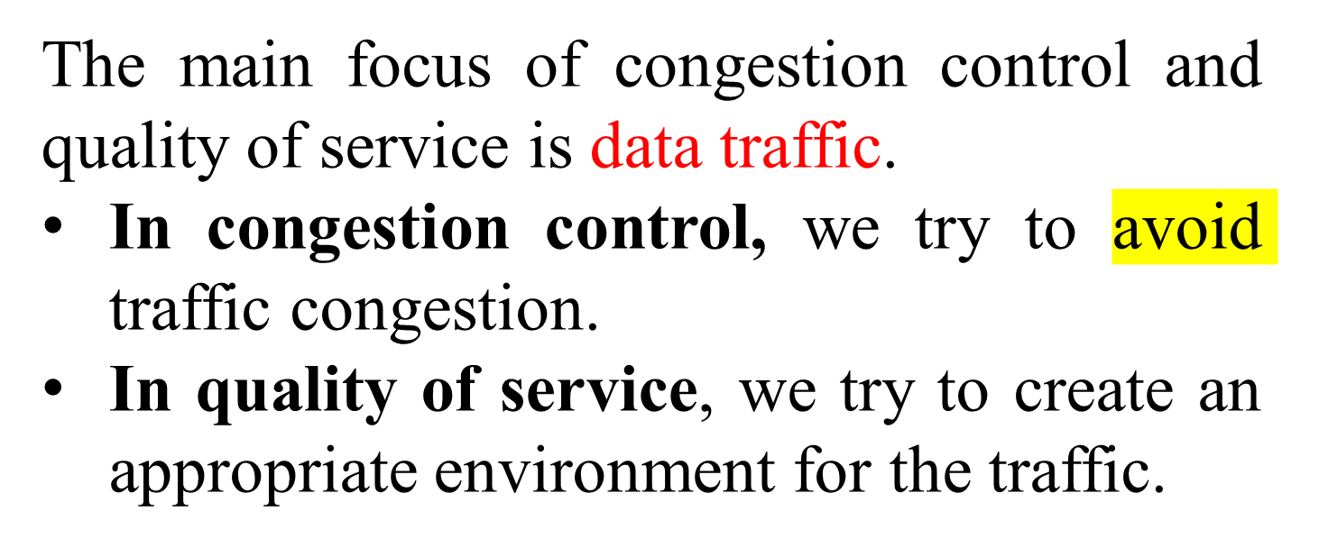
24-1 DATA TRAFFIC
24.<number>

Slide 4
24-2 CONGESTION
Congestion in a network may occur if the load on the network (the number of packets sent to the network) is greater than the capacity of the network (the number of packets a network can handle).
Congestion control refers to the mechanisms and techniques to control the congestion and keep the load below the capacity.
Topics discussed in this section:
Network Performance
24.<number>

Slide 5
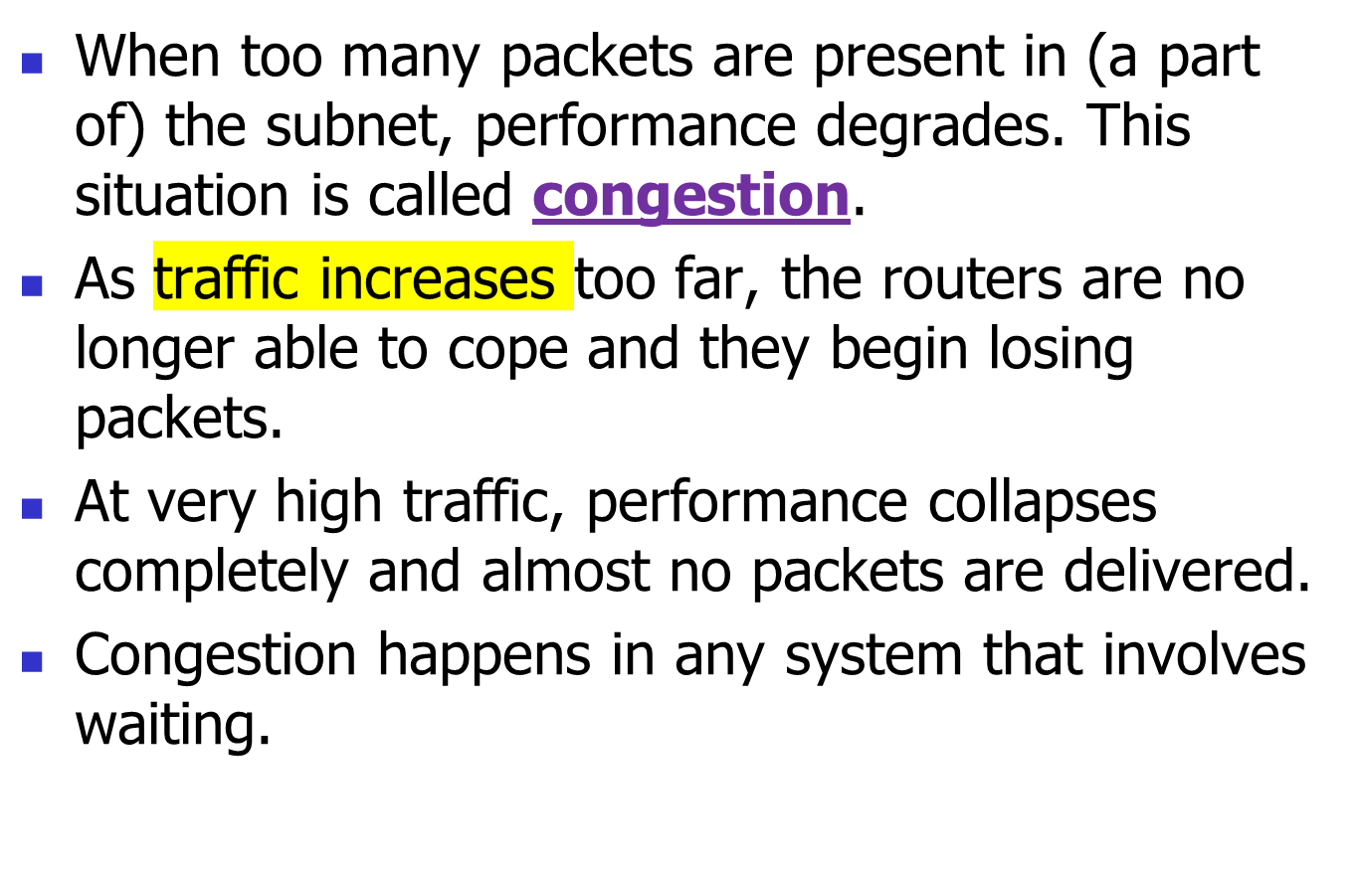
Congestion Control Introduction:

Slide 6
Congestion Control Introduction:
Reasons of Congestion:
  Slow Processors.
  High stream of packets sent from one of the sender.
  Insufficient memory.
  High memory of Routers also add to congestion as becomes un manageable and un accessible. (Nagle, 1987).
  Low bandwidth lines.

Slide 7
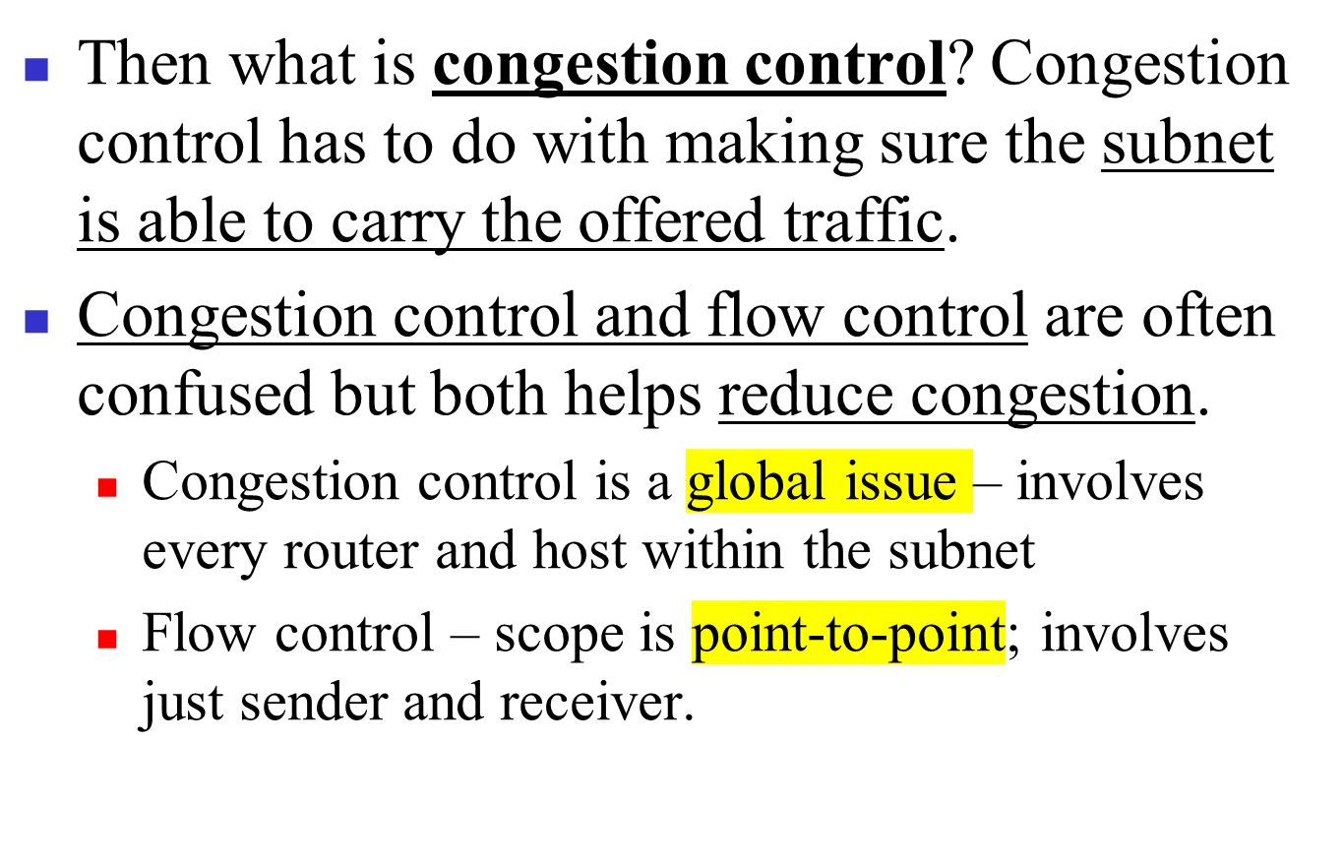
Congestion Control Introduction:

Slide 8
General Principles of Congestion Control
Three Step approach to apply congestion control:
  Monitor the system .
    detect when and where congestion occurs.
  Pass information to where action can be taken.
  Adjust system operation to correct the problem.
How to monitor the subnet for congestion.
  percentage of all packets discarded for lack of buffer space,
  average queue lengths,
  number of packets that time out and are retransmitted,
  average packet delay
  standard deviation of packet delay (jitter Control).

Slide 9
Knowledge of congestion will cause the hosts to take appropriate action to reduce the congestion.
Dividing all algorithms into
  open loop or
  closed loop

Slide 10
The presence of congestion means that the load is (temporarily) greater than the resources can handle.
Solution?
  increase the resources or
  decrease the load.
That is not always possible. So we have to apply some congestion prevention policy.

Slide 11
24-3 CONGESTION CONTROL
Congestion control refers to techniques and mechanisms that can either
prevent congestion, before it happens, or
remove congestion, after it has happened.
In general, we can divide congestion control mechanisms into two broad categories:
open-loop congestion control (prevention) and
closed-loop congestion control (removal).
24.<number>

Slide 12

Figure 24.5 Congestion control categories
24.<number>

Slide 13
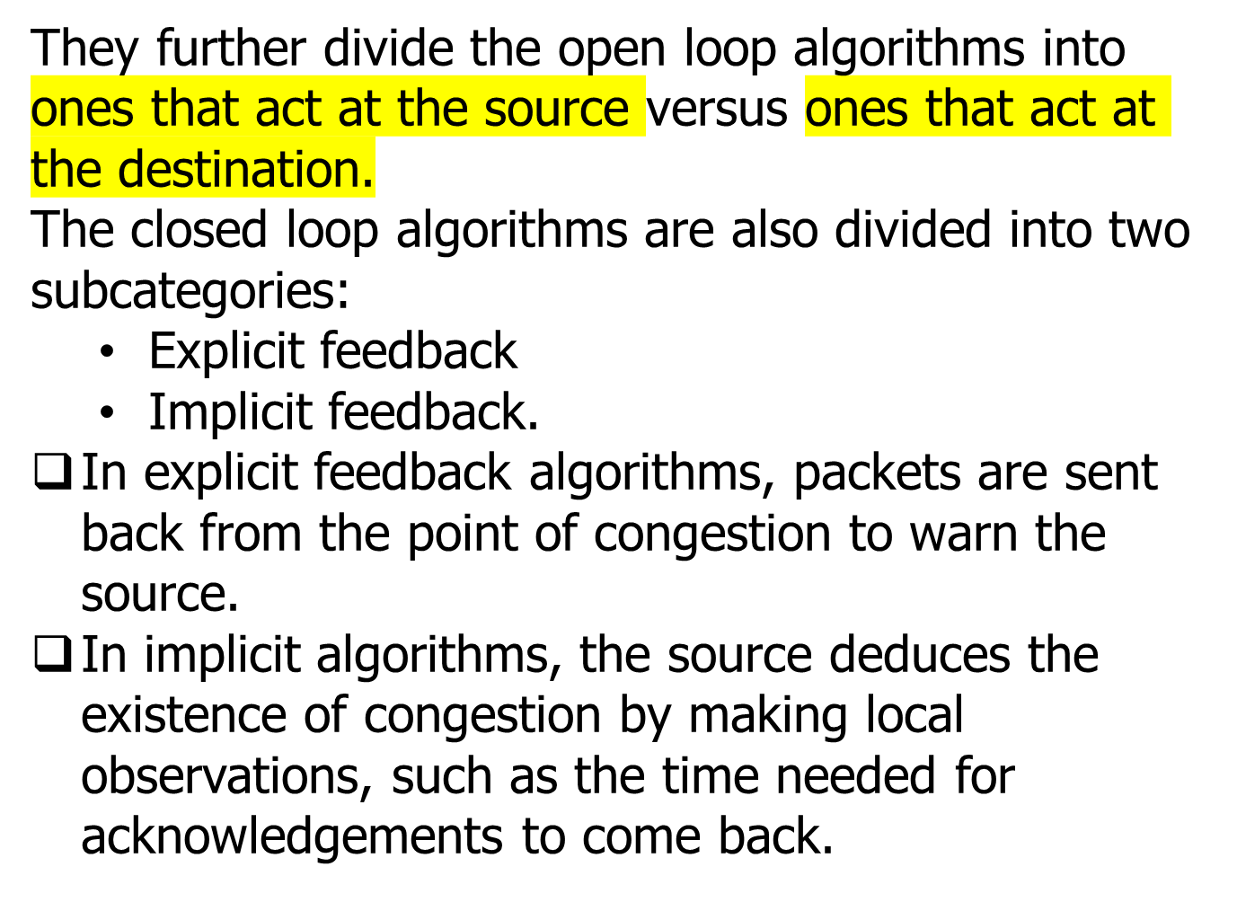
24.<number>

Slide 14
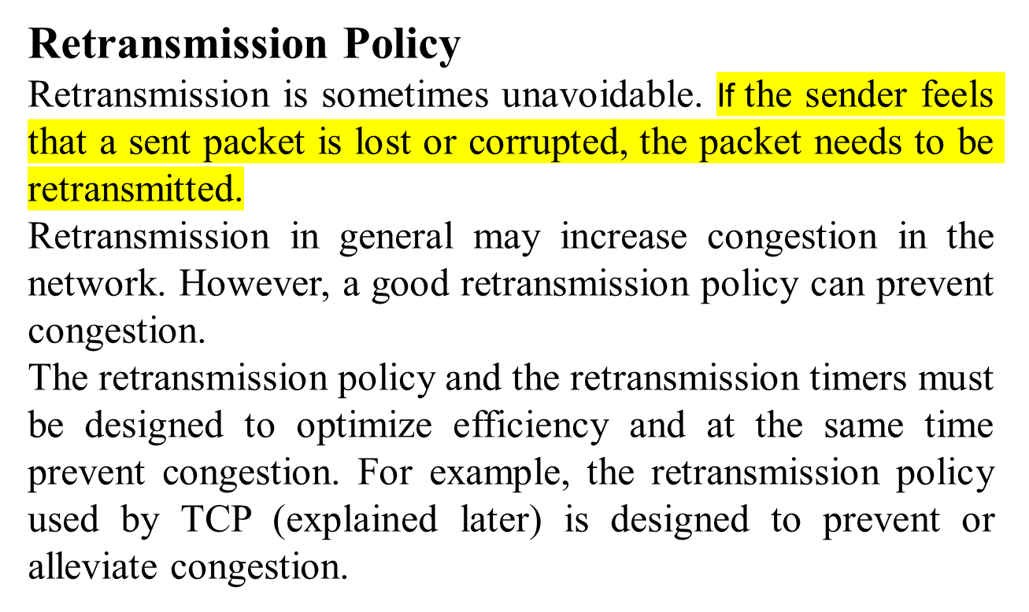
24.<number>

Slide 15
The acknowledgment policy imposed by the receiver may also affect congestion.
If the receiver does not acknowledge every packet it receives, it may slow down the sender and help prevent congestion.
Several approaches are used in this case.
  A receiver may send an acknowledgment only if it has a packet to be sent or a special timer expires.
  A receiver may decide to acknowledge only N packets at a time. We need to know that the acknowledgments are also part of the load in a network. Sending fewer acknowledgments means imposing less load on the network.
24.<number>

Slide 16
Disregarding Policy/ Load Shedding
When buffers become full, routers simply discard packets.
Which packet is chosen to be the victim depends on the application and on the error strategy used in the data link layer.
For a file transfer, for, e.g. cannot discard older packets since this will cause a gap in the received data.
For real-time voice or video it is probably better to
throw away old data and keep new packets.
Get the application to mark packets with discard priority.

Slide 17
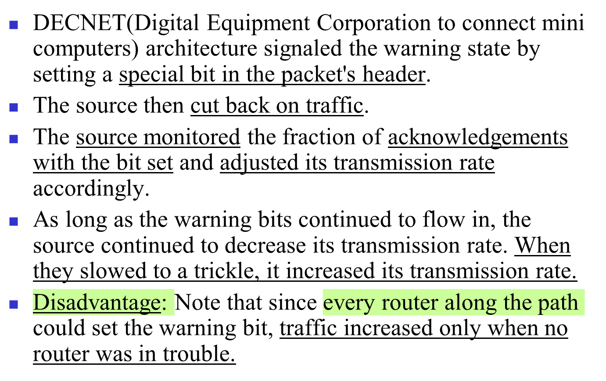
Warning Bit or Backpressure:

Slide 18

Figure 24.6 Backpressure method for alleviating congestion
24.<number>

Slide 19
Choke Packets
A more direct way of telling the source to slow down.
A choke packet is a control packet generated at a congested node and transmitted to restrict traffic flow.
The source, on receiving the choke packet must reduce its transmission rate by a certain percentage.
An example of a choke packet is the ICMP Source Quench Packet.

Slide 20
Choke Packets:
The original packet is tagged (a header bit is turned on) so that it will not generate any more choke packets farther along the path and is then forwarded in the usual way.
Router maintains threshold. And based on it gives
  Mild Warning
  Stern Warning
  Ultimatum.
Variation: Use queue length or buffers instead of line utilization as trigger signal. This will reduce traffic. Chocks also increase traffic.

Slide 21

Figure 24.7 Choke packet
24.<number>

Slide 22
Hop-by-Hop Choke Packets
This technique is an advancement over the Choked packet method. At high speed over long distances, sending a packet back to the source doesn’t help much, because by the time the choke packet reaches the source, already a lot of packets destined for the same original the destination would be out from the source.
So, to help this, Hop-by-Hop Choke packets are used. Over long distances or at high speeds choke packets are not very effective. A more efficient the method is to send choke packets hop-by-hop.
This requires each hop to reduce its transmission even before the choke packet arrives at the source.

Slide 23
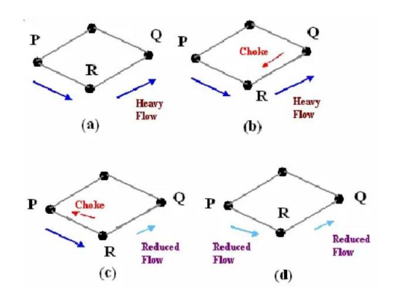
Hop-by-Hop Choke Packets

Slide 24
24-6 TECHNIQUES TO IMPROVE QoS
In this section, we discuss some techniques that can be used to improve the quality of service. We briefly discuss four common methods: scheduling, traffic shaping, admission control, and resource reservation.
Topics discussed in this section:
Scheduling (RED)
Traffic Shaping
Resource Reservation
Admission Control
24.<number>

Slide 25
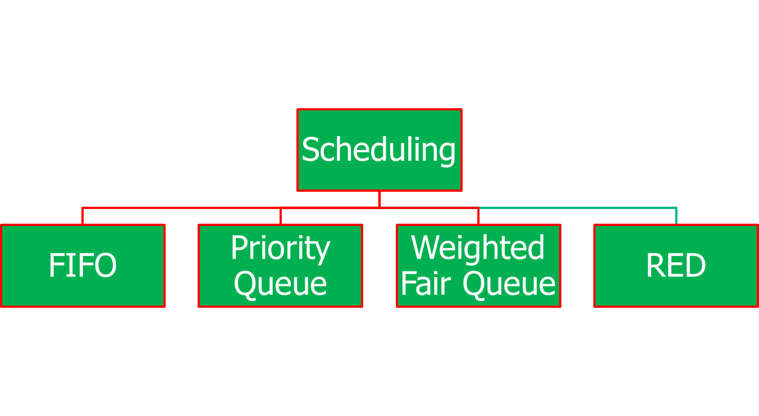
Scheduling
24.<number>

Slide 26
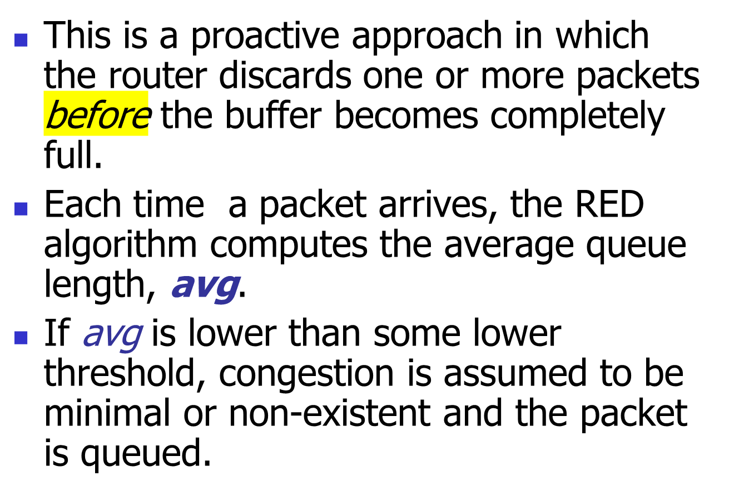
Random Early Discard (RED)

Slide 27
RED, cont.
If avg is greater than some upper threshold, congestion is assumed to be serious and the packet is discarded.
If avg is between the two thresholds, this might indicate the onset of congestion. The probability of congestion is then calculated.

Slide 28
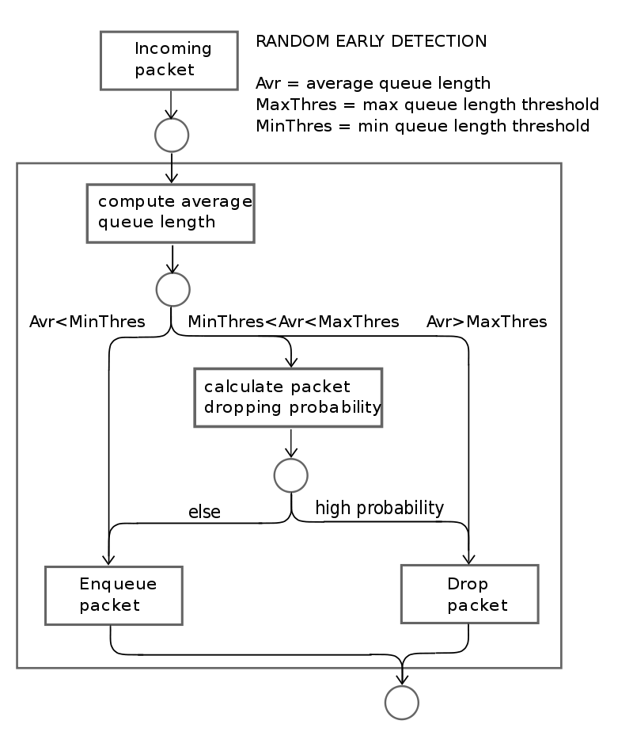
24.<number>

Slide 29
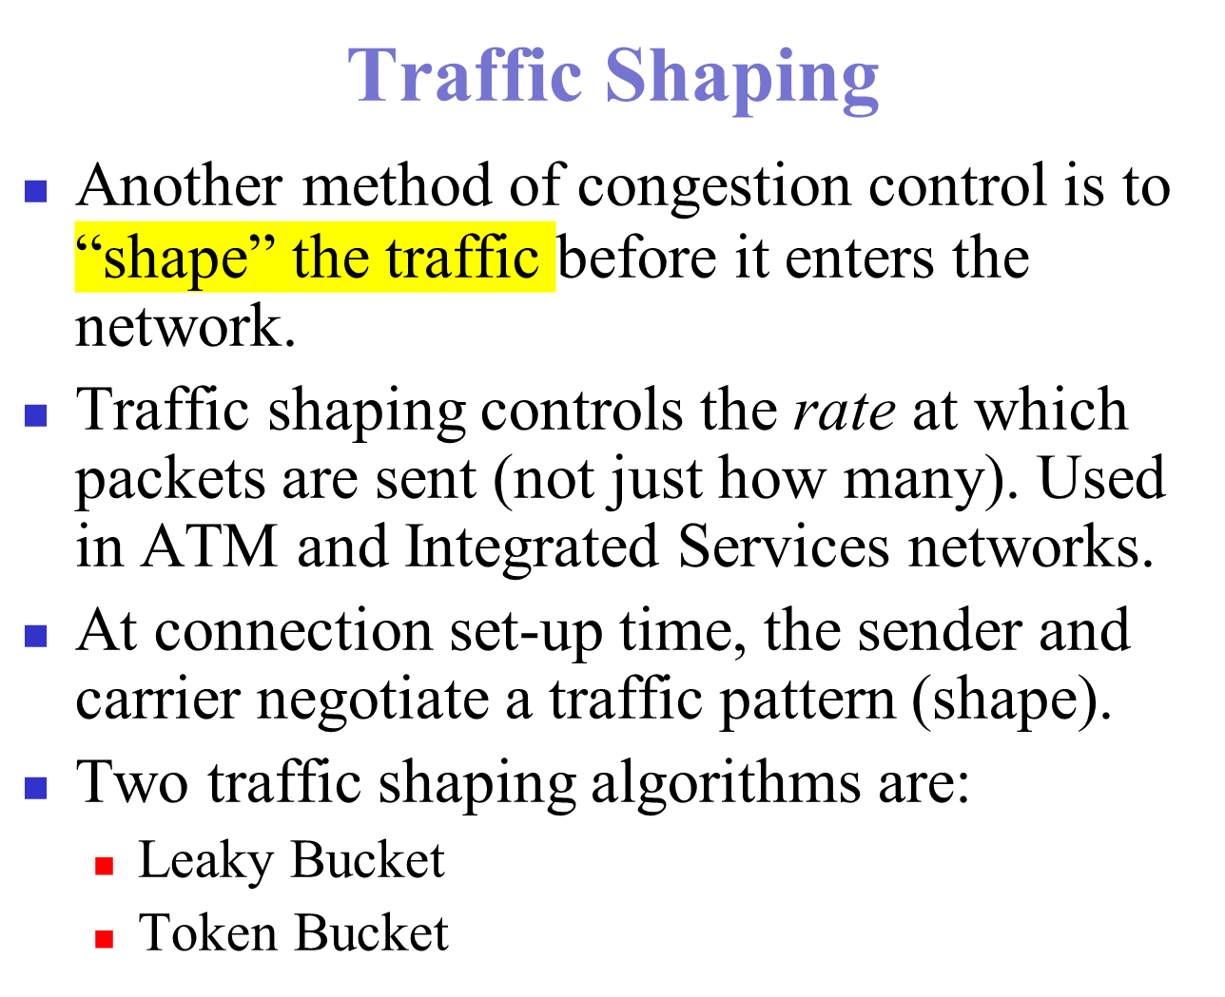

Slide 30
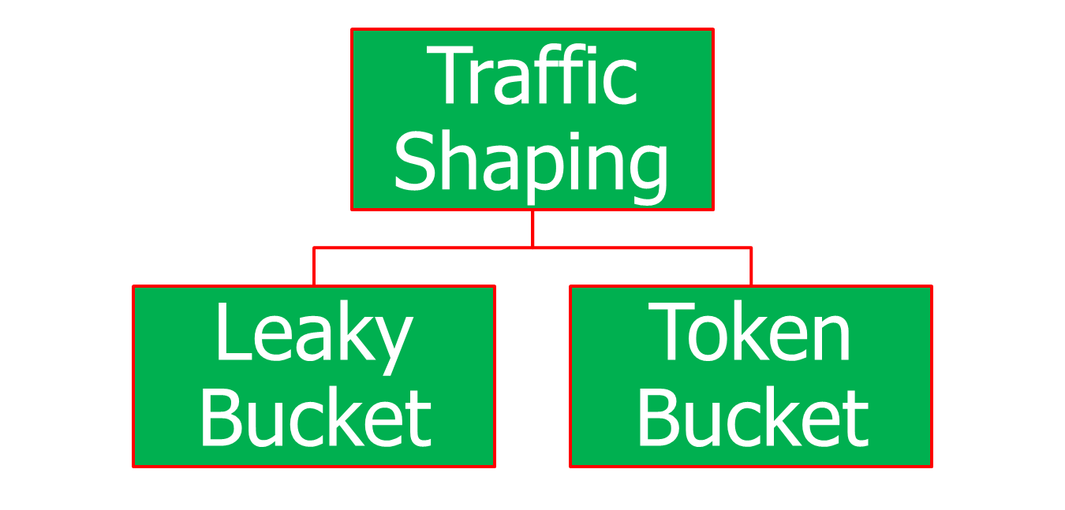
Traffic Shaping
24.<number>

Slide 31
The Leaky Bucket Algorithm
The Leaky Bucket Algorithm used to control rate in a network. It is implemented as a single-server queue with constant service time. If the bucket (buffer) overflows then packets are discarded.

Slide 32
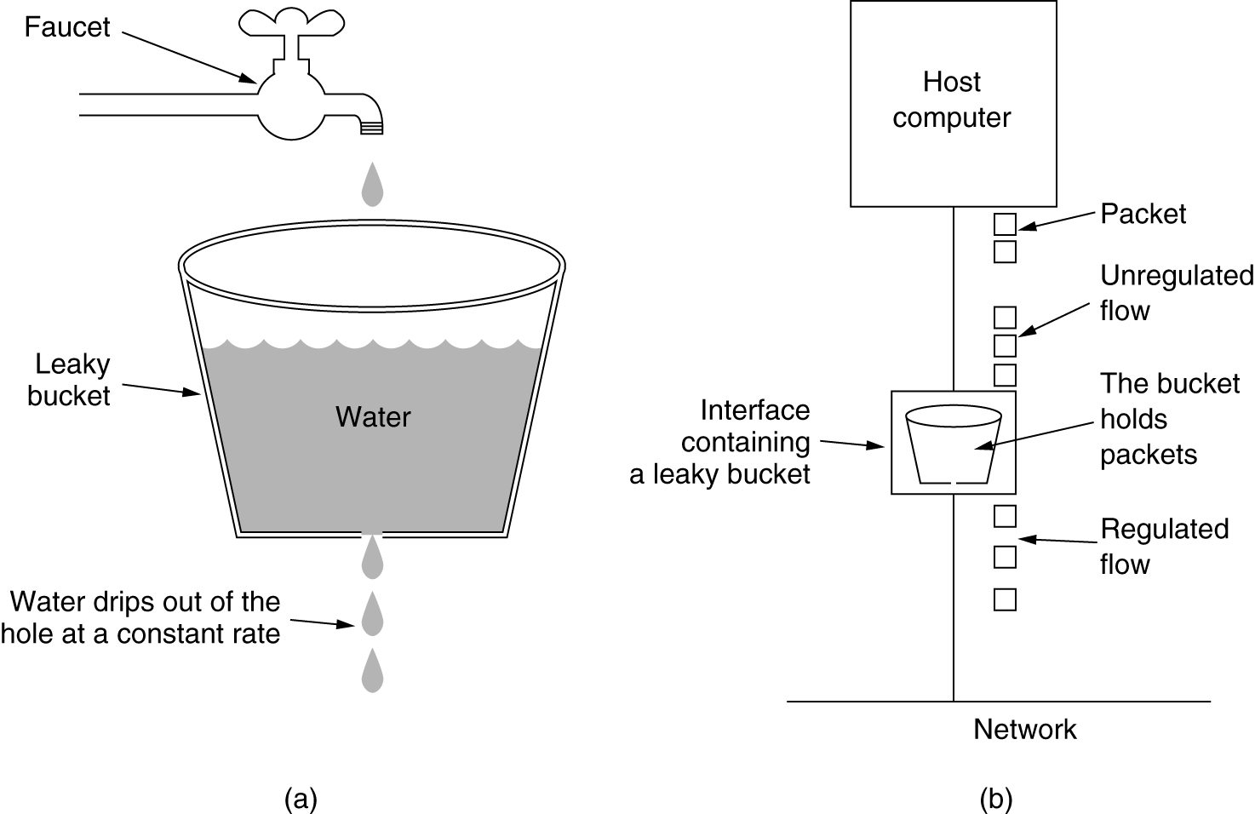
The Leaky Bucket Algorithm
(a) A leaky bucket with water. (b) a leaky bucket with packets.

Slide 33
Leaky Bucket Algorithm, cont.
The leaky bucket enforces a constant output rate (average rate) regardless of the burstiness of the input. Does nothing when input is idle.
The host injects one packet per clock tick onto the network. This results in a uniform flow of packets, smoothing out bursts and reducing congestion.
When packets are the same size (as in ATM cells), the one packet per tick is okay. For variable length packets though, it is better to allow a fixed number of bytes per tick. E.g. 1024 bytes per tick will allow one 1024-byte packet or two 512-byte packets or four 256-byte packets on 1 tick.

Slide 34

Figure 24.20 Leaky bucket implementation
24.<number>

Slide 35

Note
A leaky bucket algorithm shapes bursty traffic into fixed-rate traffic by averaging the data rate. It may drop the packets if the bucket is full.
24.<number>

Slide 36
Token Bucket Algorithm
In contrast to the LB, the Token Bucket Algorithm, allows the output rate to vary, depending on the size of the burst.
In the TB algorithm, the bucket holds tokens. To transmit a packet, the host must capture and destroy one token.
Tokens are generated by a clock at the rate of one token every Δt sec.
Idle hosts can capture and save up tokens (up to the max. size of the bucket) in order to send larger bursts later.

Slide 37
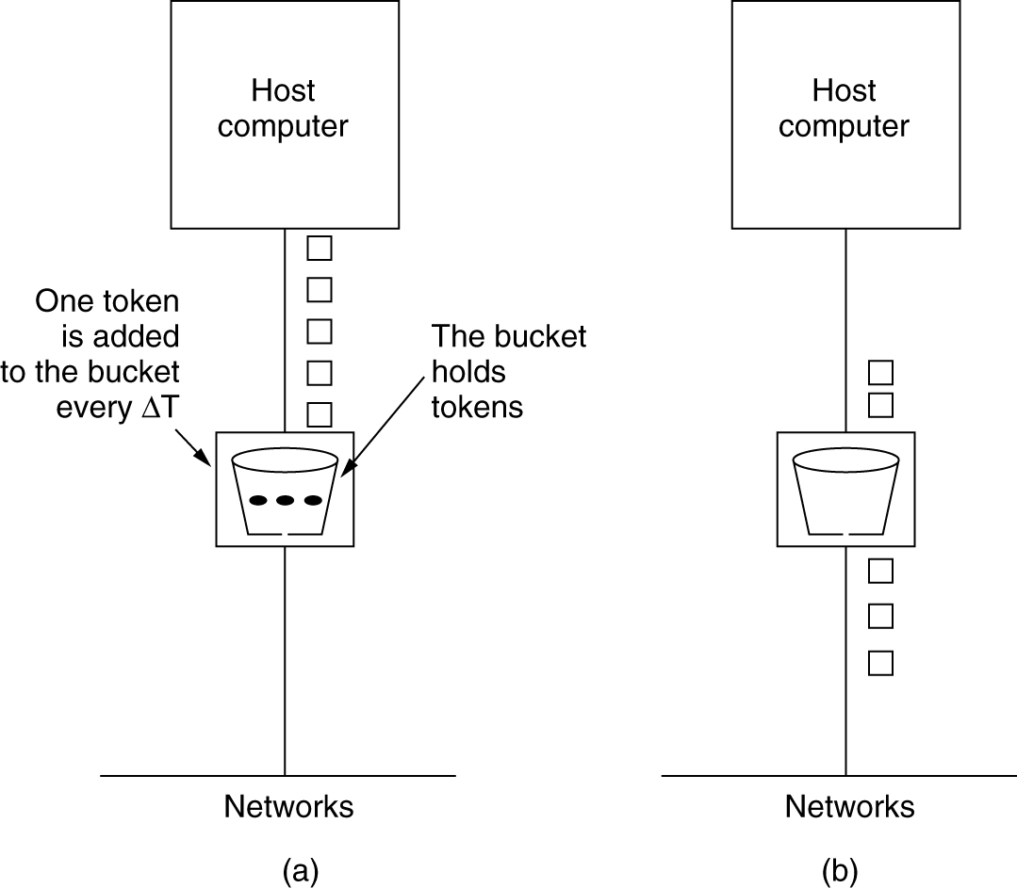
The Token Bucket Algorithm
5-34
(a) Before. (b) After.

Slide 38
Leaky Bucket vs Token Bucket
LB discards packets; TB does not. TB discards tokens.
With TB, a packet can only be transmitted if there are enough tokens to cover its length in bytes.
LB sends packets at an average rate. TB allows for large bursts to be sent faster by speeding up the output.
TB allows saving up tokens (permissions) to send large bursts. LB does not allow saving.

Slide 39

Figure 24.21 Token bucket
24.<number>

